Slide 1

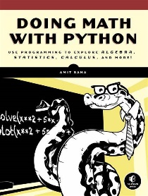

Doing Math with Python Opening and Intro
001
GitHub: https://github.com/yasenstar/DoingMathWithPython
Gitee: https://gitee.com/yasenstar/DoingMathWithPython
Yasen – Enterprise Architecture
YouTube: @yasenzhao

Slide 2
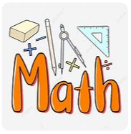
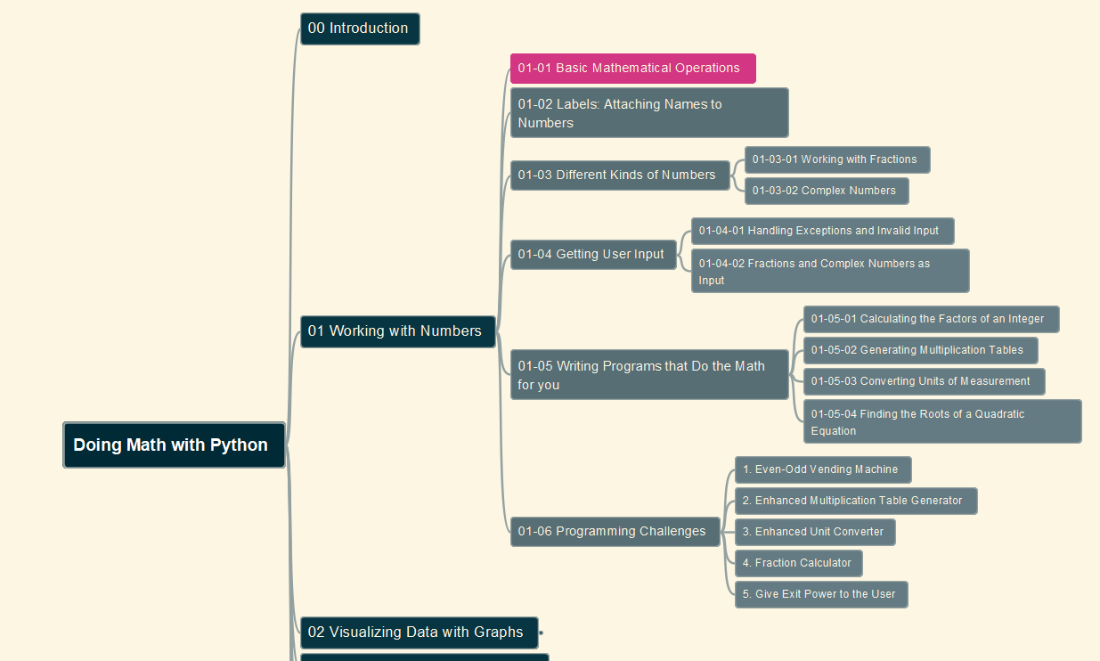
Doing Math with Python
002
Chapter 01: Working with Numbers
01-01 Basic Mathematical Operations
GitHub: https://github.com/yasenstar/DoingMathWithPython
Gitee: https://gitee.com/yasenstar/DoingMathWithPython
Yasen – Enterprise Architecture
YouTube: @yasenzhao

Slide 3
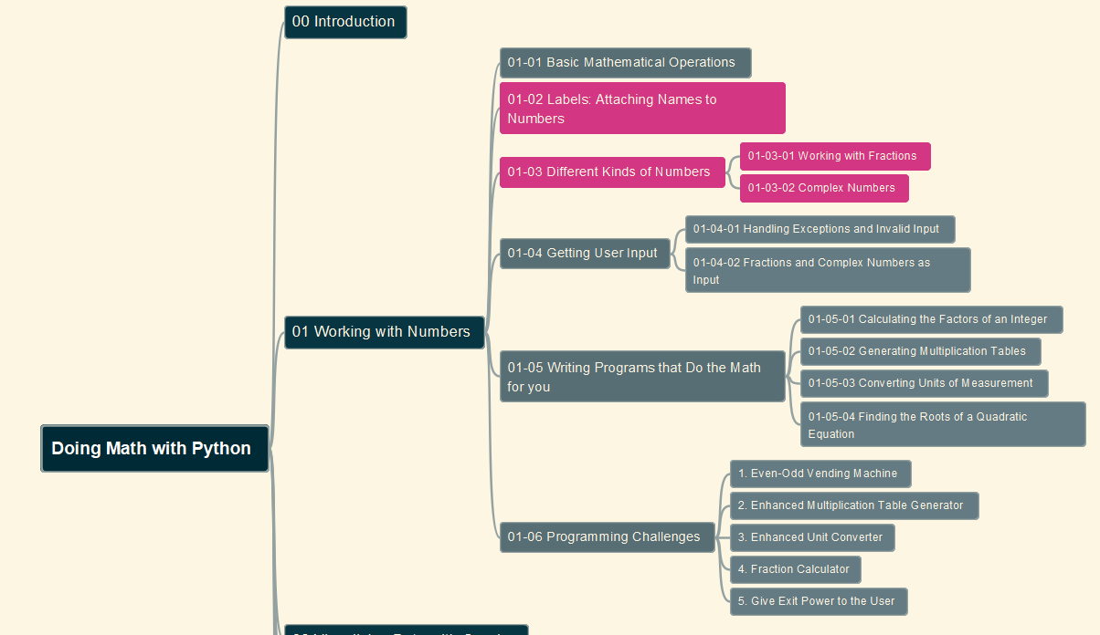
Doing Math with Python
003
Chapter 01: Working with Numbers
01-02 Labels: Attaching Names to Numbers
01-03 Different Kinds of Numbers
GitHub: https://github.com/yasenstar/DoingMathWithPython
Gitee: https://gitee.com/yasenstar/DoingMathWithPython
Yasen – Enterprise Architecture
YouTube: @yasenzhao

Slide 4
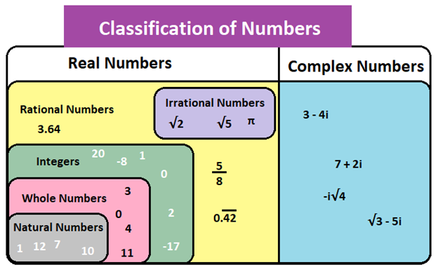
About Number’s Definition and Range

Slide 5
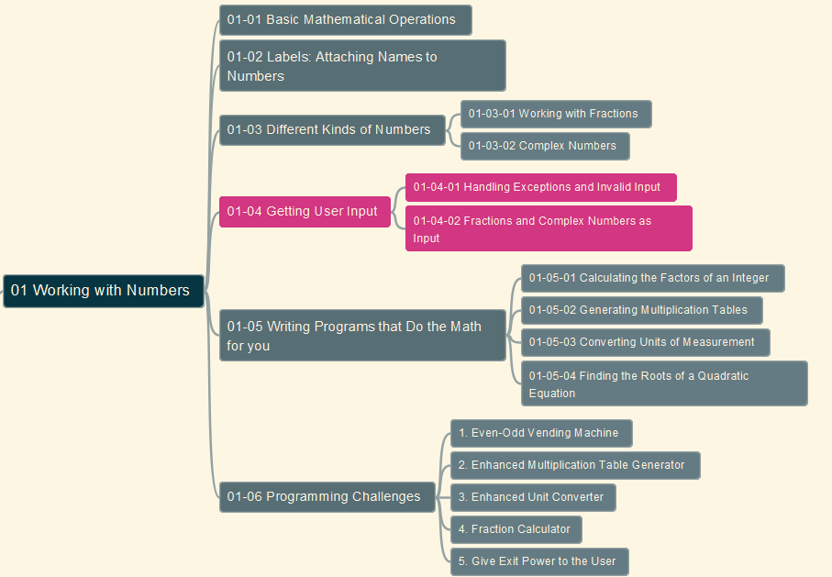
Doing Math with Python
004
Chapter 01: Working with Numbers
01-04 Getting User Input
GitHub: https://github.com/yasenstar/DoingMathWithPython
Gitee: https://gitee.com/yasenstar/DoingMathWithPython
Yasen – Enterprise Architecture
YouTube: @yasenzhao

